Slide 1

Spatial Analysis of Confirmed COVID-19 Cases in Mainland China Post-Wuhan Travel Quarantine
Group 8: Christian Geofroy, Gloria Lim , Ziran Jeffrey Zhou
Notes:
Hi, we are group 8 and this is our project presentation on the spatial analysis of confirmed COVID-19 cases in Mainland China Post-Wuhan Travel Quarantine.

Slide 2

Introduction
December 2019: The first confirmed COVID-19 case was reported in Wuhan City, Hubei Province, China.
January 23rd, 2020: A city-wide quarantine was implemented. [1]
January 30th, 2020: World Health Organization (WHO) declared the Coronavirus disease (COVID-19) outbreak as a Public Health Emergency of International Concern (PHEIC) [2]

Slide 3

Problem
A quarantine implementation will have significant impacts on the health system, economic functions, and the daily lives of society.
How long will this last?
What is the impact of a COVID-19 quarantine measure on the rate of transmission of this outbreak?

Slide 4
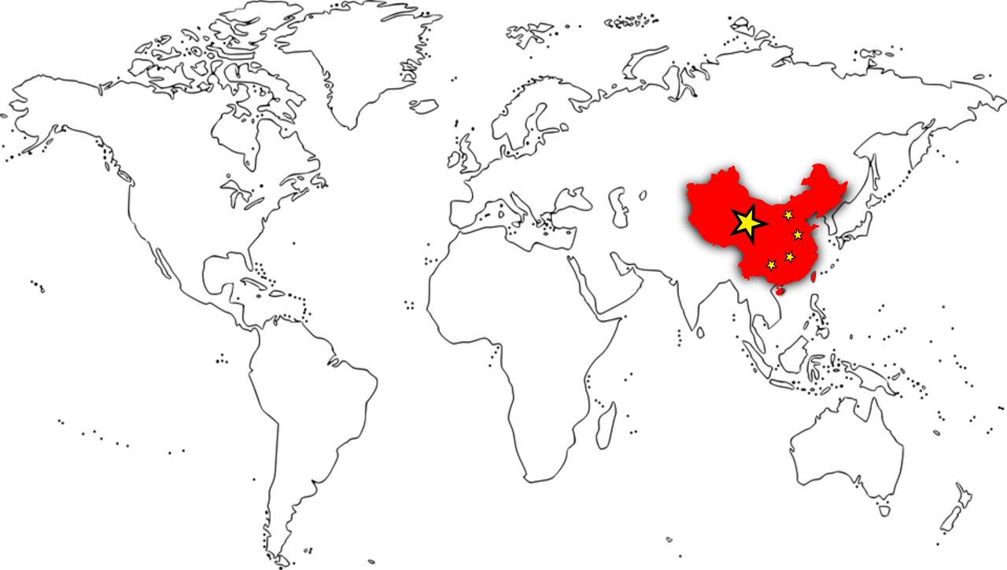
Objectives
The aim of this study is to explore the spatial-temporal distribution of the confirmed coronavirus cases within the provinces in Mainland China.
To identify the association between a travel quarantine implementation and the resulting rate of coronavirus transmission

Slide 5
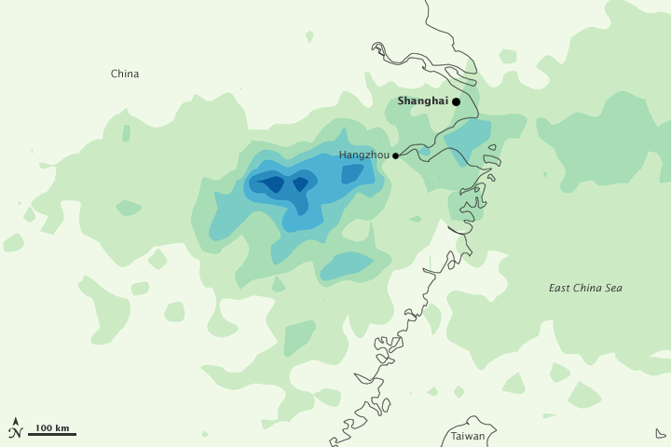
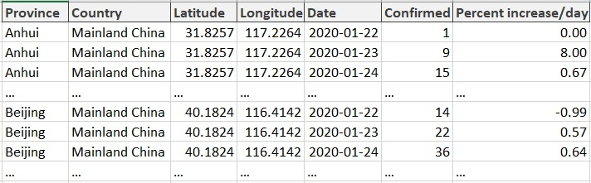
Methodology
Obtained raw data from John Hopkins 2019 Novel Coronavirus COVID-19 (2019-nCoV) Data Repository
Data pre-processing: created a date column & calculated percent increases of number of cases/ day
Table 1: Header of pre-processed data.

Slide 6
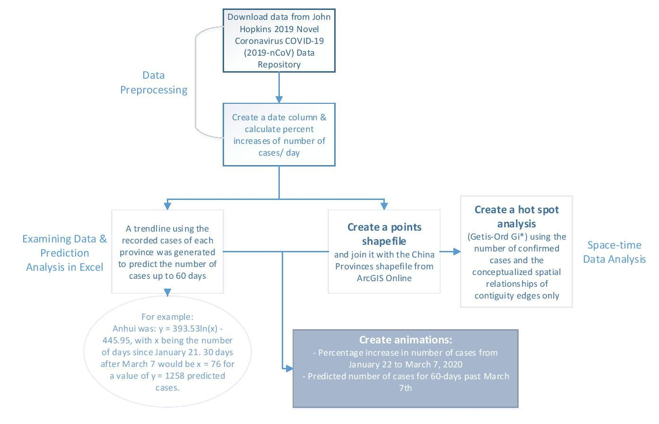
Methodology
Notes:
After data pre-processing:
A trendline using the recorded cases of each province was generated to predict the number of cases up to 60 days.
For example: Anhui was: y = 393.53ln(x) - 445.95, with x being the number of days since January 21. 30 days after March 7 would be x = 76 for a value of y = 1258 predicted cases.
Create a points shapefile from this data and join it with the China Provinces shapefile from ArcGIS Online
Create animations from this joined file of percentage increase in number of cases from January 22 to March 7, 2020 and another with predicted number of cases for 60-days past March 7th
Create a hot spot analysis (Getis-Ord Gi*) using the number of confirmed cases and the conceptualized spatial relationships of contiguity edges only

Slide 7
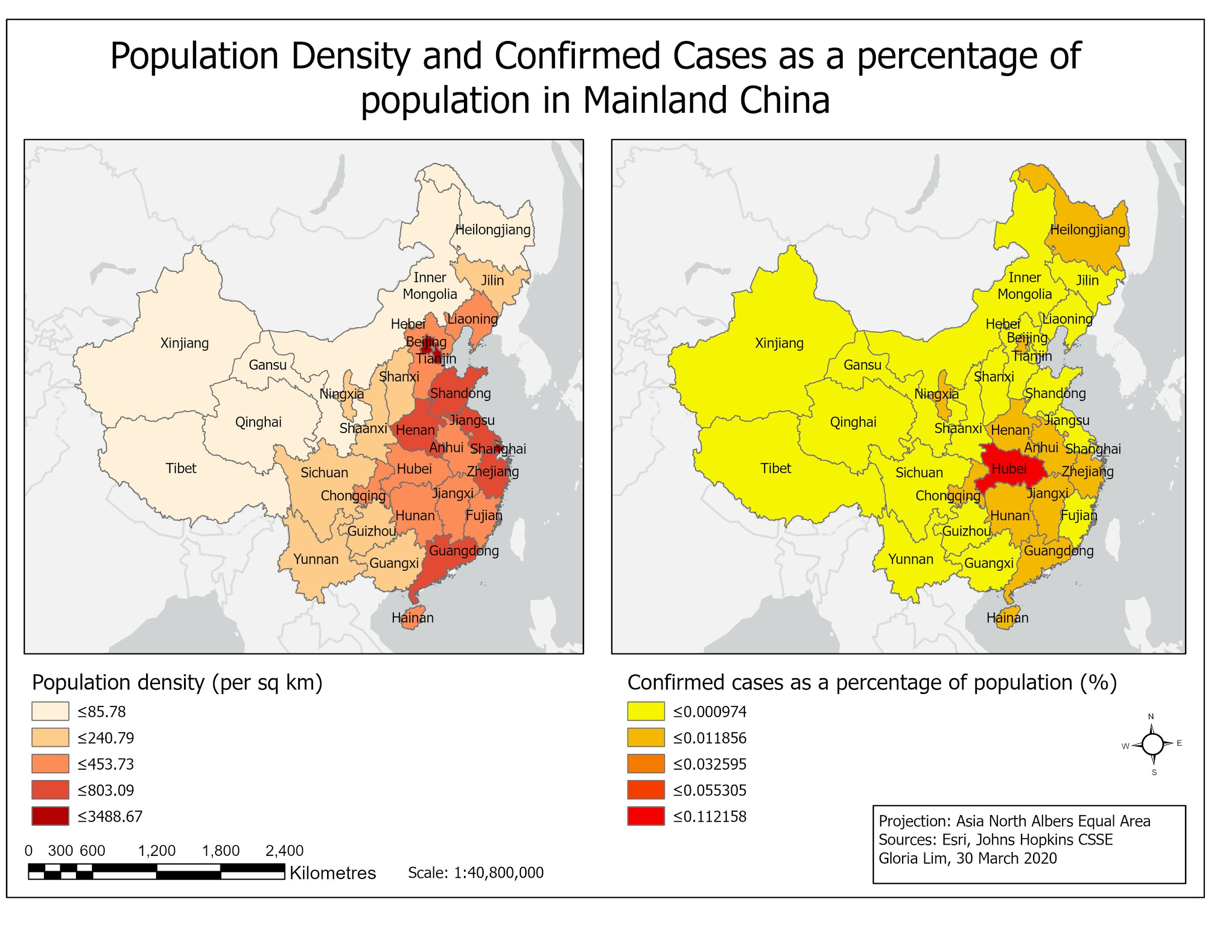
Results & Analysis
Examining the demographics of the country:
Reference maps of the population density of China as of March 2020, and the number of confirmed cases of COVID-19 as a ratio to the population of each province.

Slide 8
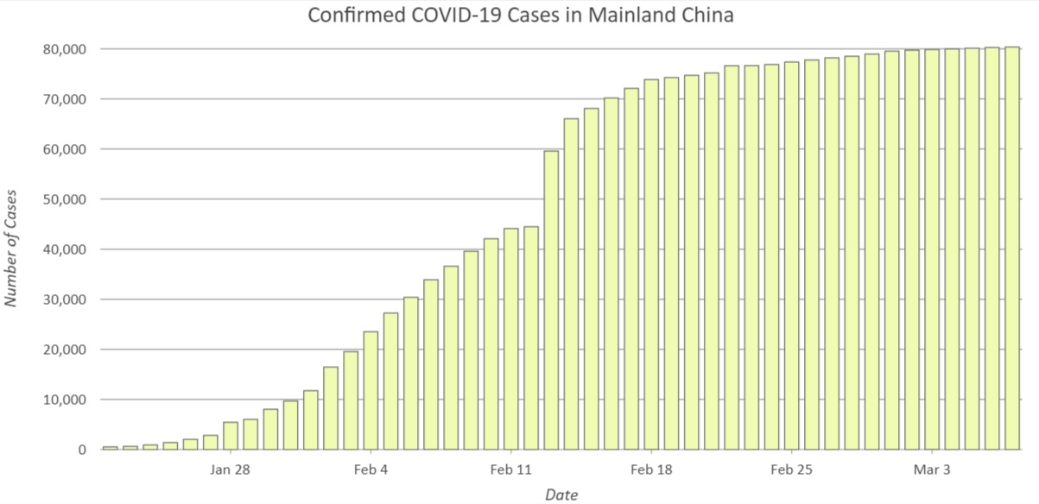
Results & Analysis
A steep curve between January 25th and February 15th (2 weeks)
Significant decrease in the percentage of new cases after Feb 15
Prediction suggests no further large outbreaks (> 25%)
Graph 1: Cumulative number of confirmed COVID-19 cases in Mainland China between January 22nd to March 7th.
(Quarantine implemented on the 23rd)
Notes:
Significance of research findings

Slide 9
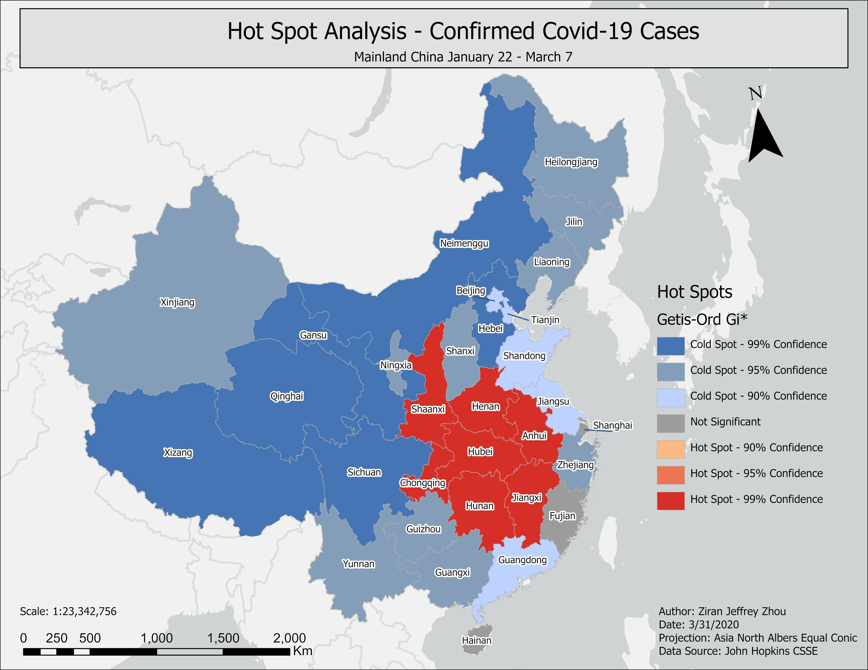
Results - Hot Spot Analysis
Results of Hot Spot Analysis of the confirmed cases of COVID-19. Shows that only the provinces adjacent to Hubei are significant hot spots, and the quarantine worked in stopping the spread

Slide 10
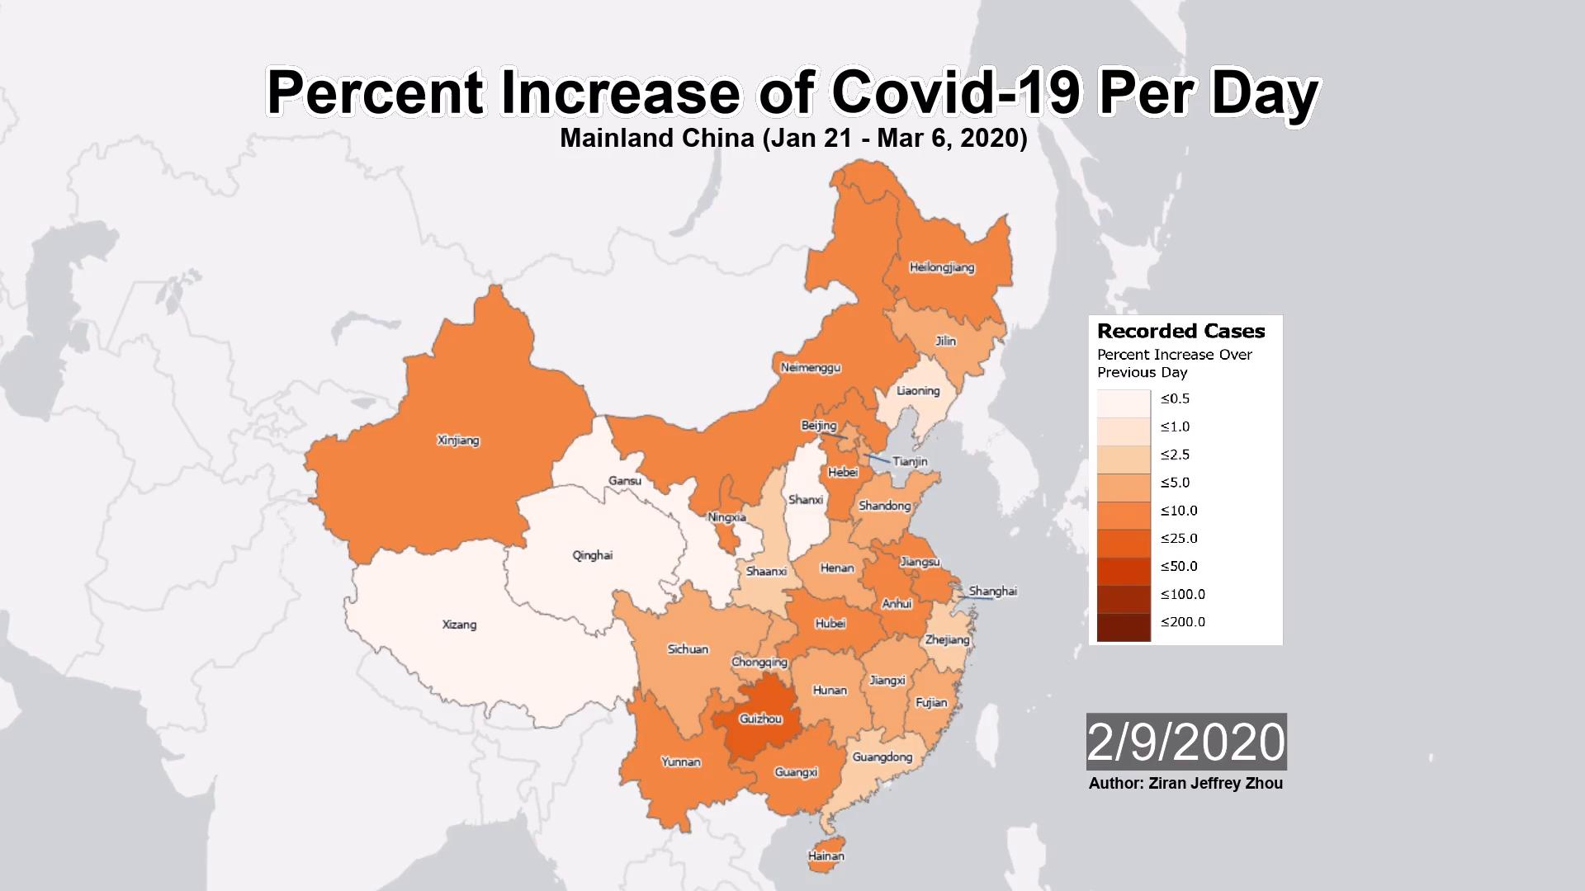
Discussion - Percent Increase of Cases
Animation showing the percent increase of cases
Increase of no more than 10% for the majority of provinces after Feb 15.
With the exception of Gansu, there are no increases greater than 5% after February 21.

Slide 11
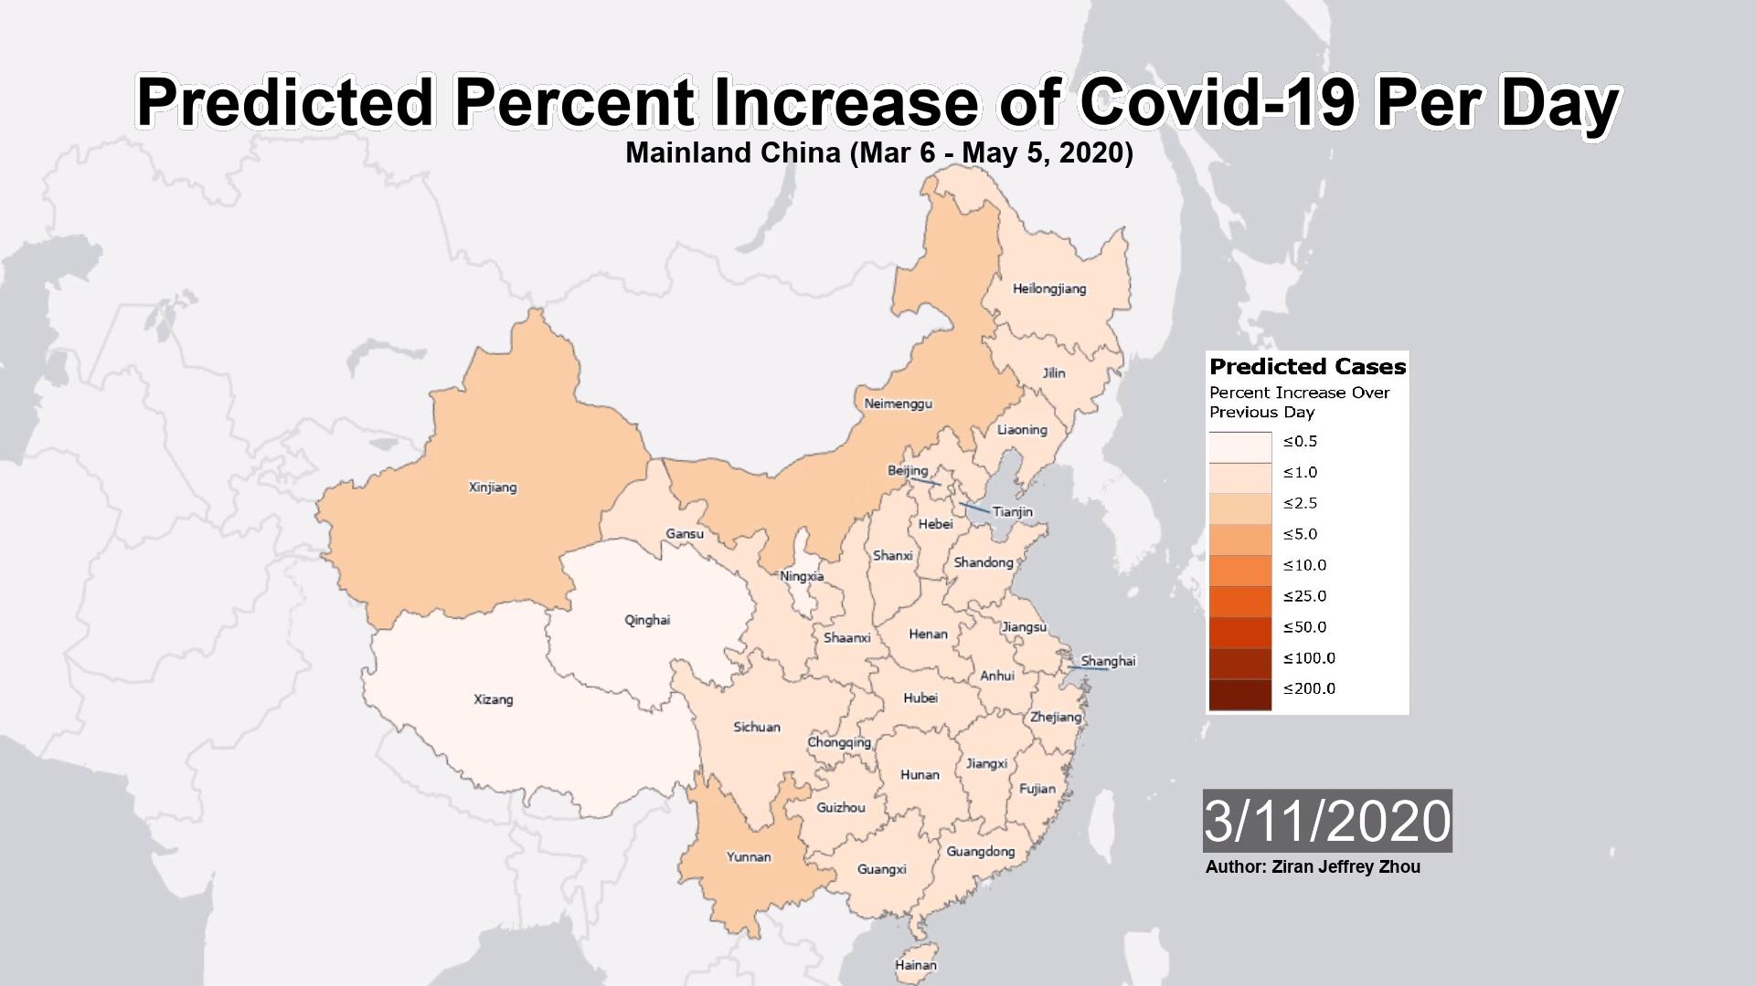
Discussion- Predicted Increase of Cases
Animation showing the predicted percent increase of confirmed cases per day from March 7 to April 5 2020
Predicts no further increases greater than 25% after March 7 condition remains the same

Slide 12
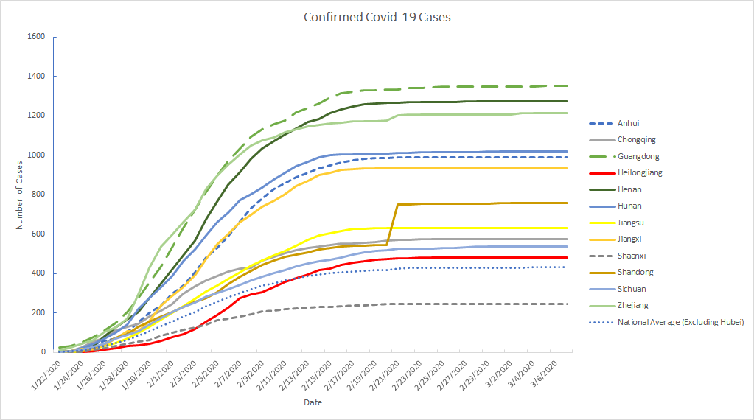
Discussion
5 of 6 provinces indicated as hot spots are above national average
Likely due to close proximity, (Tobler’s Law)
Only 6 provinces not in hot spots above national average
Quarantine effective in preventing further outbreak
Notes:
Significance of research findings

Slide 13

Conclusion
There was a significant increase of confirmed cases for a duration of 2 weeks
It was identified that only the provinces adjacent to Hubei were significant hot spots
Quarantine was effective in limiting the spread of COVID-19 in Mainland China

Slide 14

Contributions
Christian Geofroy: Helped write abstract, results, presentation slides
Gloria Lim: Helped write introduction, methodology, generate map & graphs, search for academic papers & prepare presentation slides.
Ziran Jeffrey Zhou: Helped write methodology, results, discussion. Data pre-processing, data processing and analysis, time-lapse animations, hot spot analysis.

Slide 15
References
[1] ncov – CSSE. (2020). Systems.jhu.edu. Retrieved 9 March 2020, from https://systems.jhu.edu/research/public-health/ncov/
[2] Park, M., Thwaites, R. S., & Openshaw, P. J. M. (2020). COVID-19: Lessons from SARS and MERS. European Journal of Immunology, 50(3), 308–311. https://doi.org/10.1002/eji.202070035

